Slide 1
User Defined Functions and Structures

Slide 2
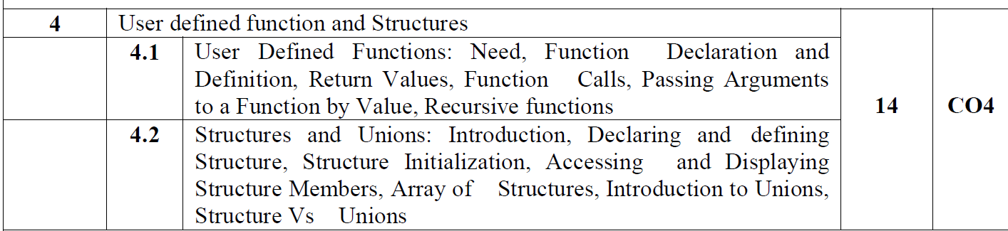

Slide 3
User defined Function
A function is a self-contained block of statements that perform a coherent task of some kind. Every C program can be thought of as a collection of these functions. As we noted earlier, using a function is something like hiring a person to do a specific job for you.

Slide 4
# include <stdio.h>
void message( ) ; /* function prototype declaration */
int main( )
{
message( ) ; /* function call */
printf ( "Cry, and you stop the monotony!\n" ) ;
return 0 ;
}
void message( ) /* function definition */
{
printf ( "Smile, and the world smiles with you...\n" ) ;
}

Slide 5
function prototype declaration: This prototype declaration indicates that message( ) is a function which after completing its execution does not return any value.
This ‘does not return any value’ is indicated using the keyword void.

Slide 6
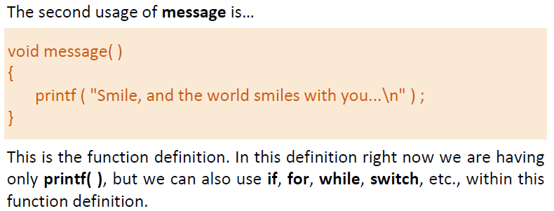

Slide 7
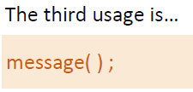
Here the function message( ) is being called by main( ).
What do we mean when we say that main( ) ‘calls’ the function message( )?
We mean that the control passes to the function message( ). The activity of main( ) is temporarily suspended; it falls asleep while the message( ) function wakes up and goes to work. When the message( ) function runs out of statements to execute, the control returns to main( ), which comes to life again and begins executing its code at the exact point where it left off.
Thus, main( ) becomes the ‘calling’ function, whereas message( ) becomes the ‘called’ function.

Slide 8
# include <stdio.h>
void italy( ) ;
void brazil( ) ;
void argentina( ) ;
int main( )
{
printf ( "I am in main\n" ) ;
italy( ) ;
brazil( ) ;
argentina( ) ;
return 0 ;
}
void italy( )
{
printf ( "I am in italy\n" ) ;
}
void brazil( )
{
printf ( "I am in brazil\n" ) ;
}
void argentina( )
{
printf ( "I am in argentina\n" ) ;
}

Slide 9
A number of conclusions can be drawn from this program:
A C program is a collection of one or more functions.
If a C program contains only one function, it must be main( ).
If a C program contains more than one function, then one (and only one) of these functions must be main( ), because program execution always begins with main( ).
There is no limit on the number of functions that might be present in a C program.
Each function in a program is called in the sequence specified by the function calls in main( ).
After each function has done its thing, control returns to main( ).
When main( ) runs out of statements and function calls, the program ends.

Slide 10
Write a general-purpose function to convert any given year into its Roman equivalent. Use these Roman equivalents for decimal numbers: 1 – I, 5 – V, 10 – X, 50 – L, 100 – C, 500 – D, 1000 – M.
Example:
Roman equivalent of 1988 is mdcccclxxxviii.
Roman equivalent of 1525 is mdxxv.

Slide 14
A positive integer is entered through the keyboard. Write a function to obtain the prime factors of this number.
For example, prime factors of 24 are 2, 2, 2 and 3, whereas prime factors of 35 are 5 and 7.

